Slide 1
Lab 1
Programming Environment

Slide 2
Agenda
.ipynb vs .py
Jupyter Notebook
Integrated Development Environment (IDE)
Visual Studio Code (VSCode)
Extension: Python (Microsoft)
Debug Mode

Slide 3
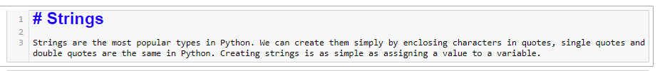
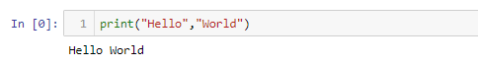
.ipynb
An IPYNB file is a notebook document used by Jupyter Notebook, an interactive computational environment designed to help scientists work with the Python language and their data
Markdown Block
Code Block
Reference: https://fileinfo.com/extension/ipynb

Slide 4
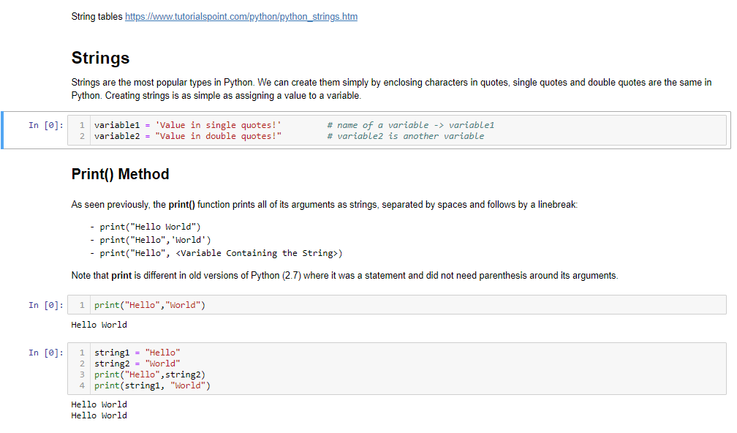
.ipynb

Slide 5
.py
A PY file is a program file or script written in Python, an interpreted object-oriented programming language
You can open a .py file using IDE / notepad editor
Code ONLY
Reference: https://fileinfo.com/extension/py

Slide 6
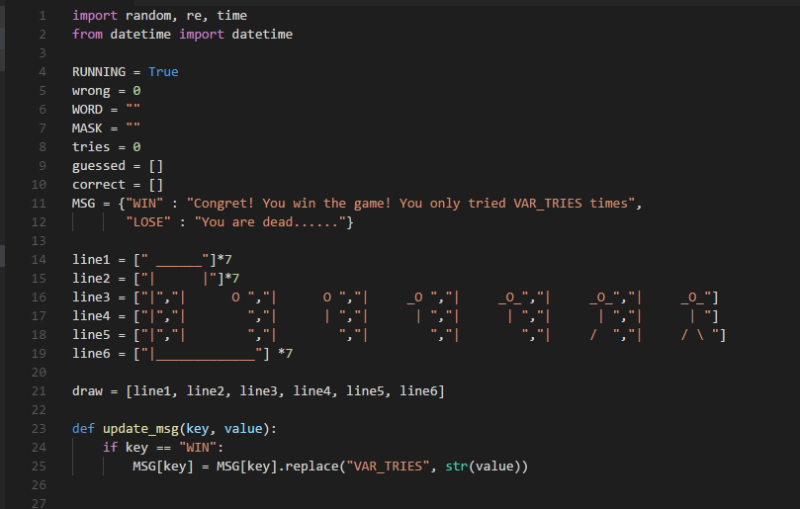
.py

Slide 7

Jupyter Notebook
https://www.youtube.com/watch?v=LrMOrMb8-3s
Installation: 0:05 - 3:37
Jupyter Notebook: 3:44 - 6:30

Slide 8
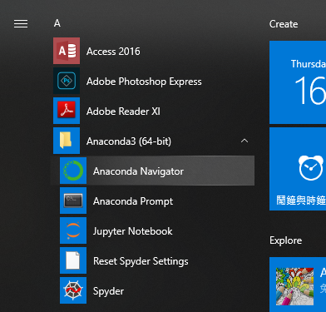
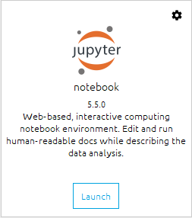
Jupyter Notebook
In the start menu, choose Anaconda3 ->
Right click -> Anaconda Navigator
Choose Run as Administrator
Launch Jupyter notebook

Slide 9
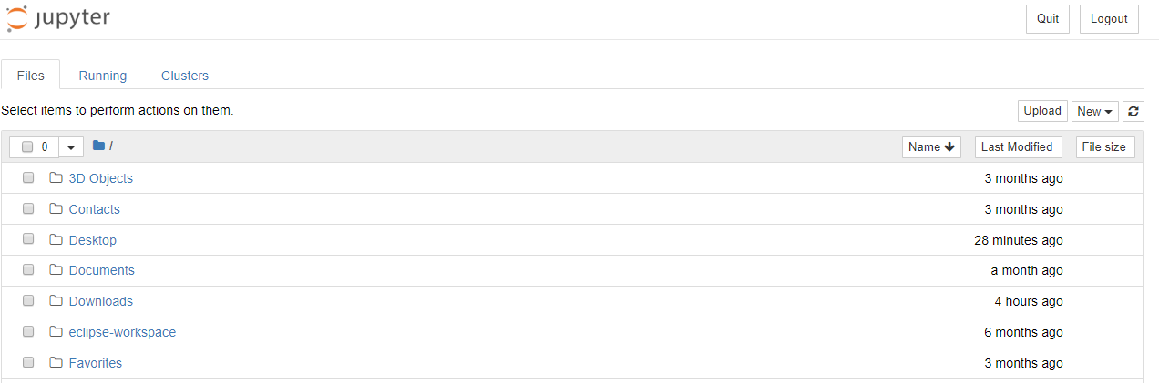
Jupyter Notebook
= C:\Users\username

Slide 10
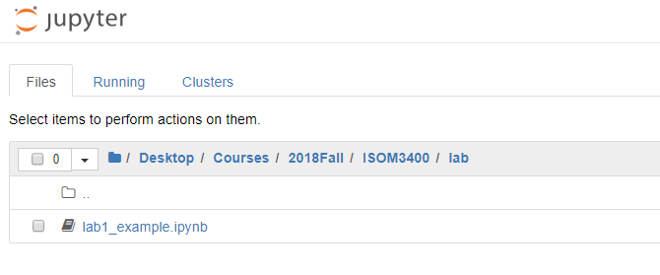
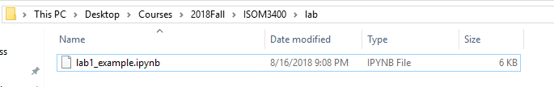
Jupyter Notebook
=C:\Users\username\Desktop\Courses\2018Fall\ISOM3400\lab

Slide 11
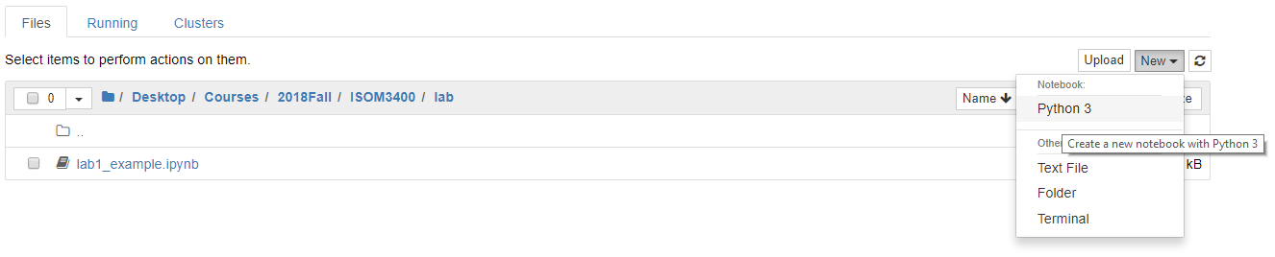
Create a new ipynb file

Slide 12
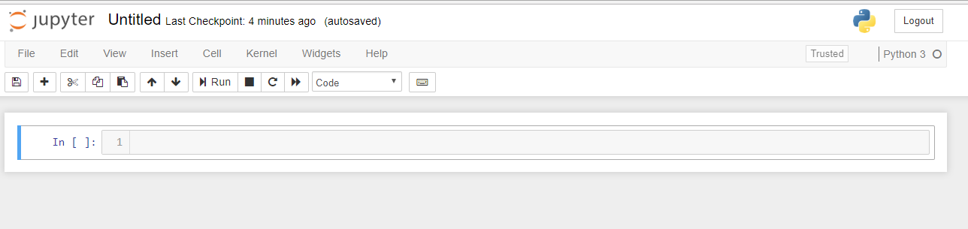
Create a new ipynb file

Slide 13
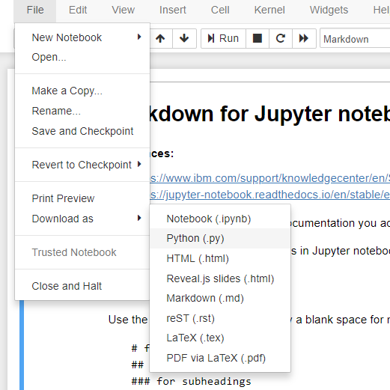
Convert ipynb to py
File -> Download as -> Python(.py)
All Markdown Content becomes comments

Slide 14
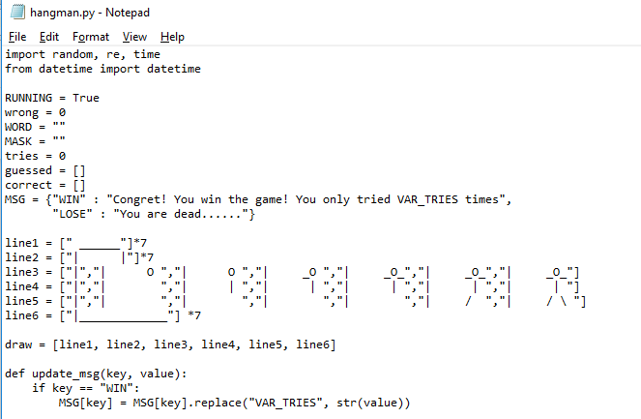
Integrated Development Environment (IDE)
Editor for coding, debugging …

Slide 15

Visual Studio Code
https://www.youtube.com/watch?v=dNFgRUD2w68
Start from 7:55

Slide 16
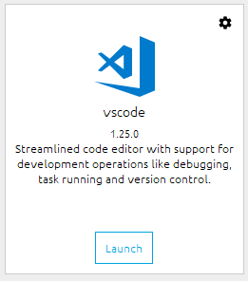
VSCode
In the start menu, choose Anaconda3
Right click -> Anaconda Navigator
Choose Run as Administrator
Launch vscode

Slide 17
VSCode
Open Folder (the folder that contains your project / source code files)
Create a .py file and start writing your program
Test / Debug

Slide 18
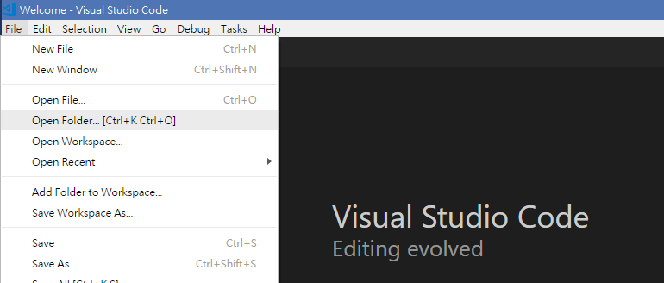
Open Folder
File -> Open Folder [Ctrl + K Ctrl + O]
Select the downloaded lab material folder

Slide 19
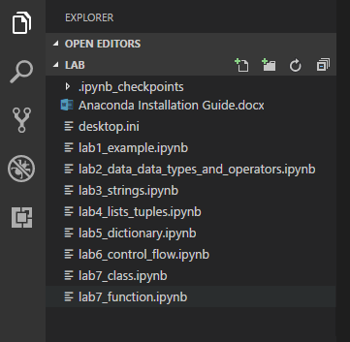
Open Folder
Four Buttons:
New File
New Folder
Refresh
Collapse All

Slide 20
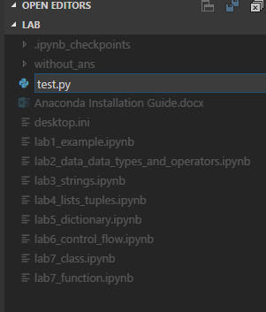
Create a .py file
Click New File button
Enter the file name: test.py
**you need to type the file extension .py

Slide 21
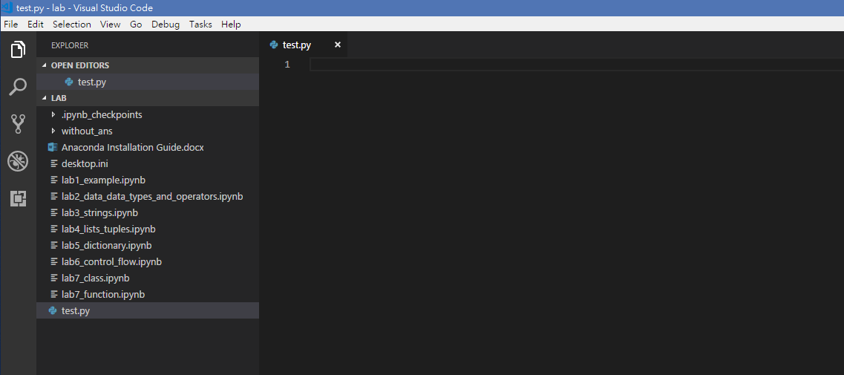
Start Writing Code Happily!

Slide 22
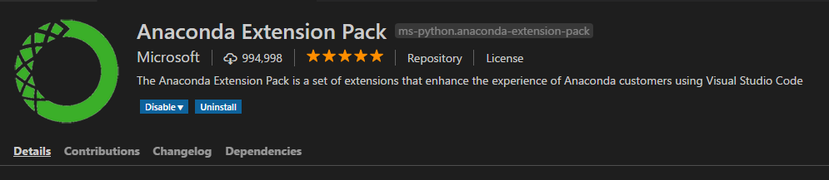
VSCode Extension
There are many extensions (useful tools) you can add on your vscode
Anaconda Extension Pack by Microsoft is recommended to be installed in your working environment
Click the button (Ctrl + Shift + X)
Search: Anaconda Extension Pack
Click install and wait

Slide 23
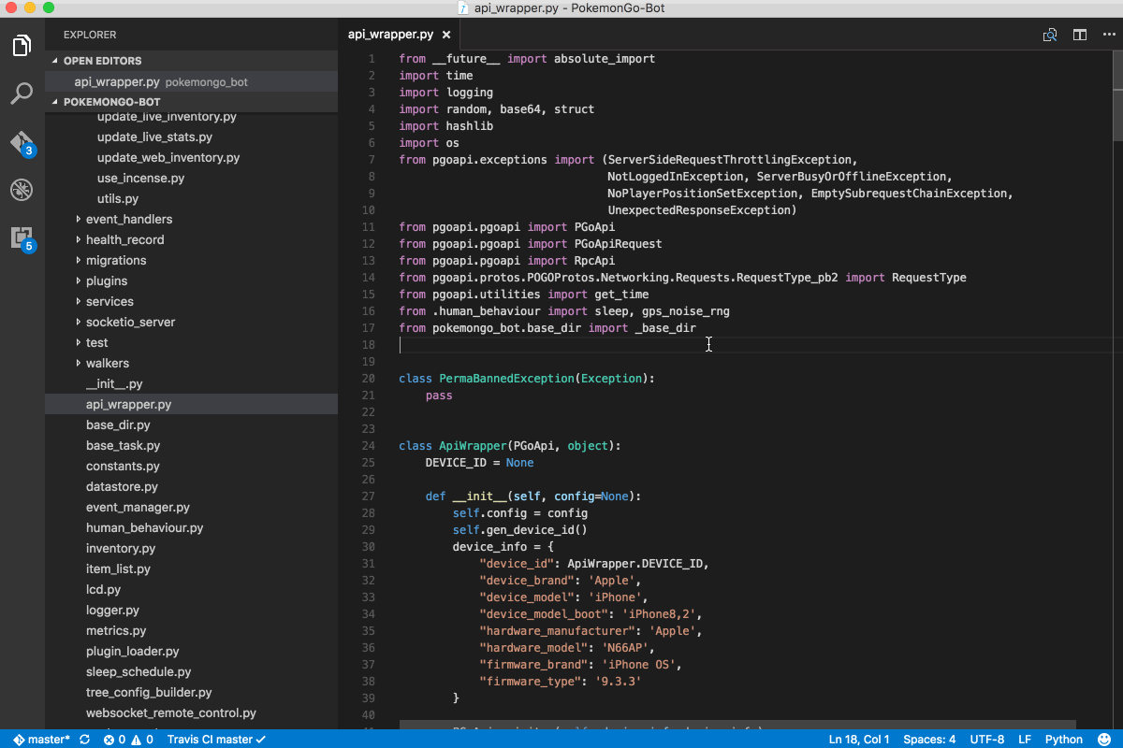
Example

Slide 24
Debugging
When the result is not what we expect
You cannot find out the mistakes
No error (The program runs perfectly, but the result is not the same as expected)
Set breakpoint
Check the values of in memory through out the program

Slide 25
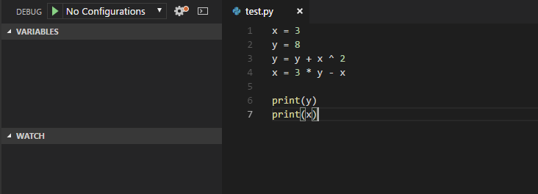
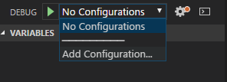
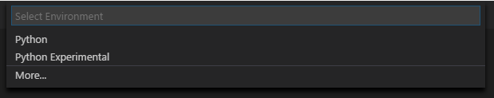
Debug Mode – Add configuration
Click the button (Ctrl + Shift + D)
Click the pull down “No Configurations”
Choose Add Configuration
Choose Python

Slide 26
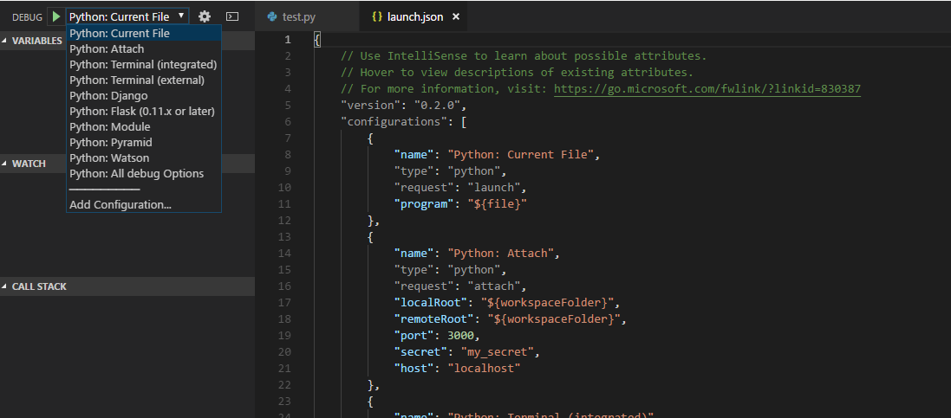
Debug Mode – Add configuration

Slide 27
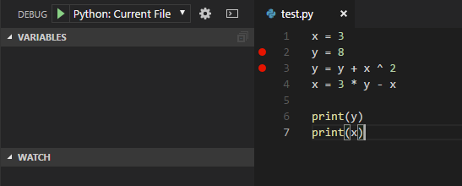
Debug Mode – Set Breakpoint
When you run a python program, the program will execute the codes line by line until the end
If you want to pause at some points (code lines), you can add some breakpoints
Click the “Play” button to start debugging

Slide 28
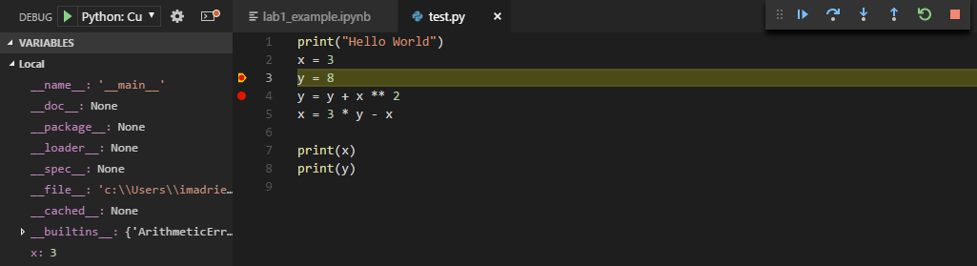
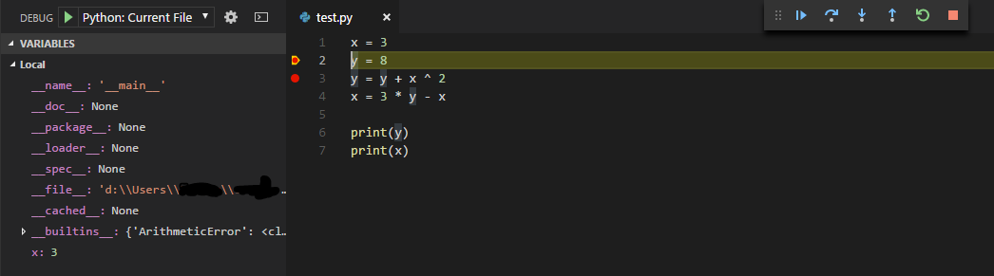
Debug Mode – Start Debugging
After line 1, variable x = 3 is in memory
You can click (F5) to continue the program until the next breakpoint / the end
Or, click (F10) to run the program line by line (slowly) to see the changes

